Slide 1
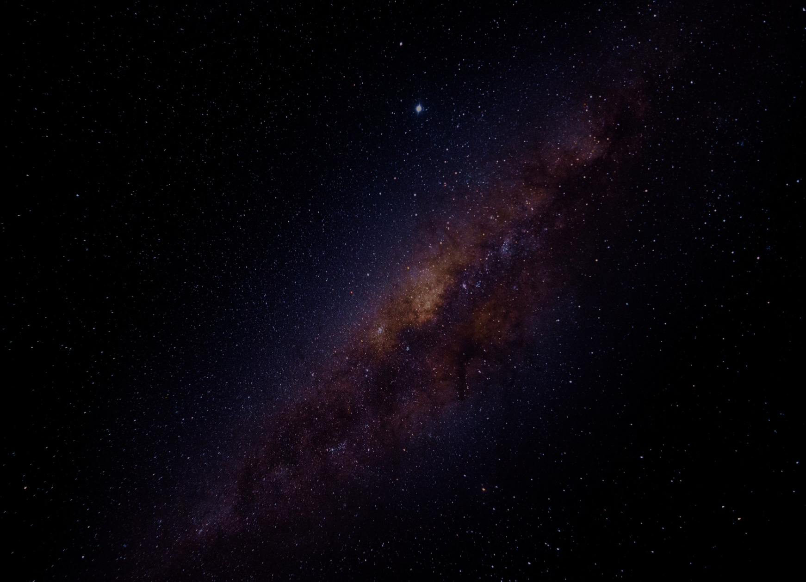


Predicting Exoplanet Habitability from NASA using Machine Learning and Data Analysis
Samia Mahmood
DS-450: Data Science Senior Capstone
January 11, 2026
1

Slide 2
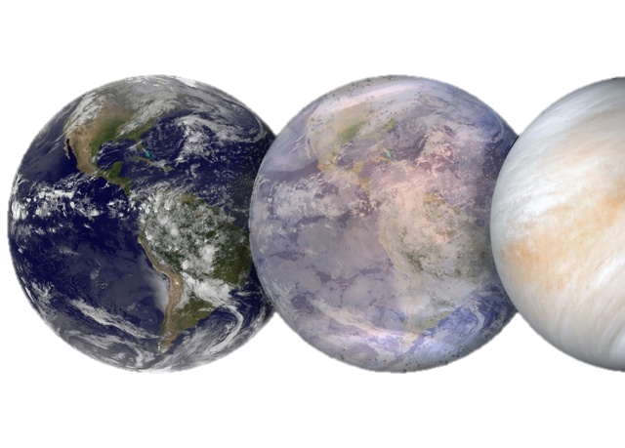
Project Overview (Problem & Proposed Solution)
Problem to Solve:
Currently know of one habitable planet, Earth → Could there be more?
Rapid growth of exoplanet discoveries → created challenges in studying exoplanets:
Outpaced our ability to efficiently characterize and assess habitability
Astronomical datasets are large-scale, high-dimensional, and incomplete, making manual analysis difficult
Proposed Solution:
Apply a structured reproducible data analytics and machine learning framework
Analyze exoplanet and stellar properties using NASA’s Exoplanet Archive
Use predictive modeling and classification to:
Explore relationships between stellar and planetary properties
Classify exoplanets
Identify natural groupings of exoplanets
Predict exoplanet habitability potential
Determine top 5 Earth-analog candidates
2

Slide 3
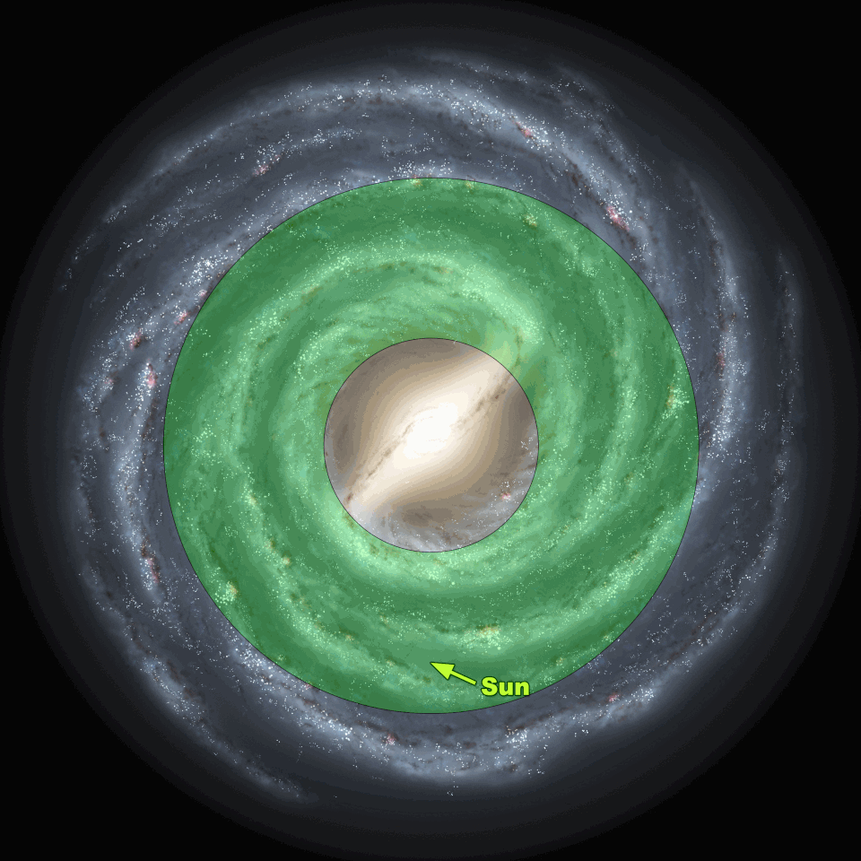
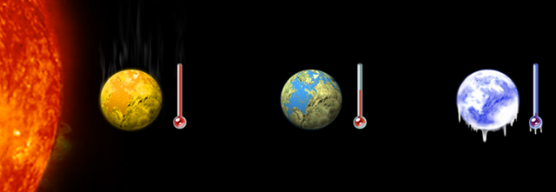
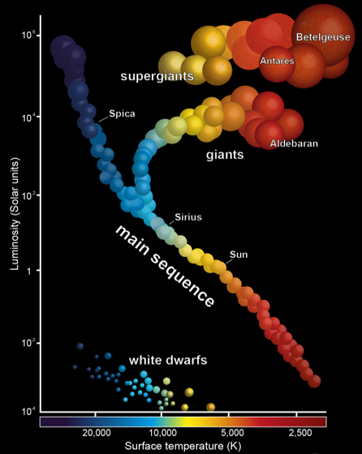
Project Idea & Scientific Motivation
Over 6,071 confirmed exoplanets discovered from ground- & space- based missions
Habitability criteria based on established astrophysical models
The goal of this project
Earth- or Super-Earth-sized rocky planets
Orbiting Sun-like (Type-G) Main Sequence stars
Located within the Habitable Zone (HZ) Inside the Galactic Habitable Zone (GHZ)
1 unsupervised learning model
2 supervised learning models
Based on key planetary and stellar features
Using data analysis and 3 machine learning models
Demonstrate application of computational modeling in Astronomy and Astrophysics.
Accelerate the discovery process of exoplanets.
Enhance understanding of exoplanet formation, classification, habitability.
3

Slide 4
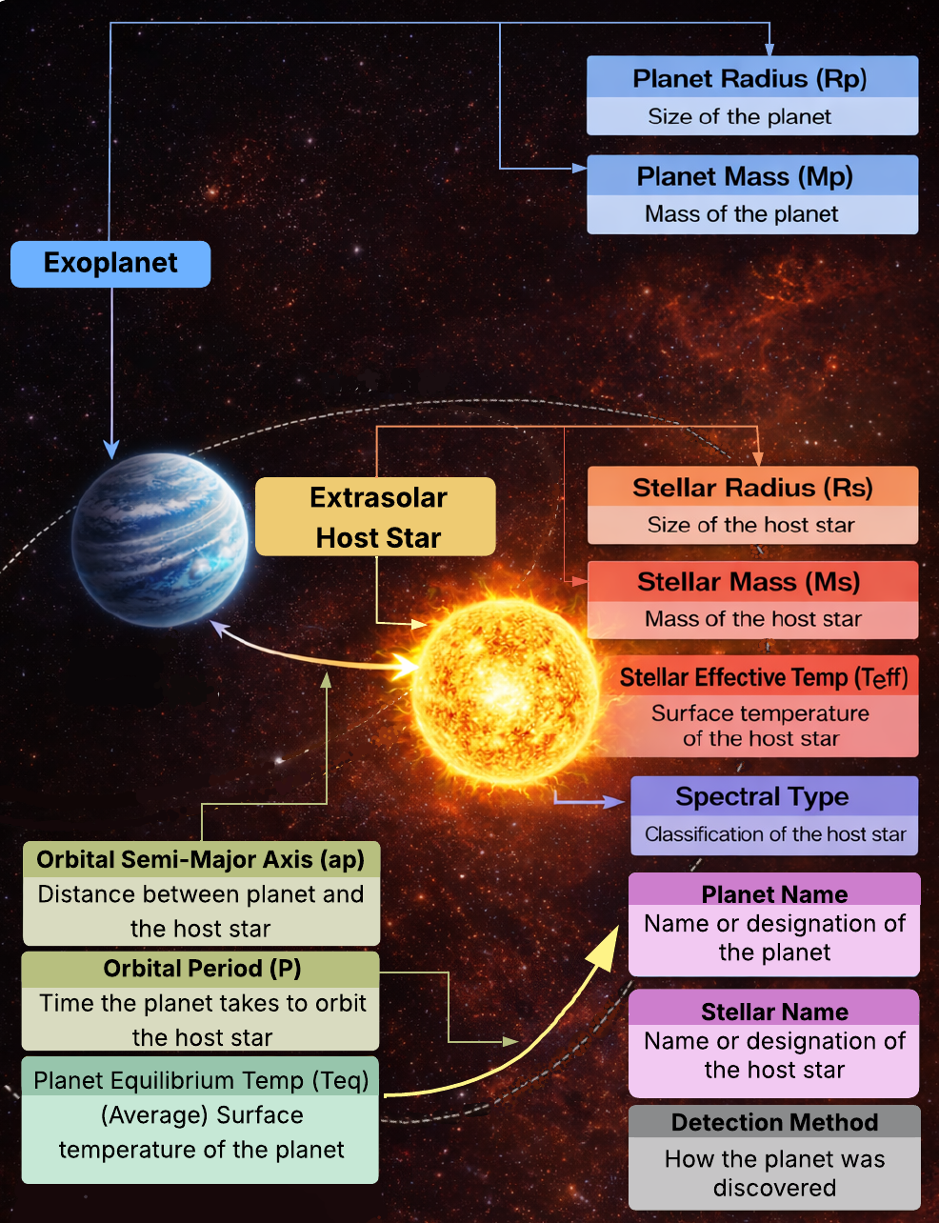
Dataset Background
Source: NASA exoplanet archive (open-source provided by NASA)
Contains 87 columns and 39,332 rows
Analytical challenges which require data cleaning and feature selection:
Duplicate rows for a single exoplanet
Redundant attributes
Missing data of important attributes
Typographical errors
Key planetary and stellar features:
Planet mass (In Earth mass)
Planet radius (In Earth radius)
Planet equilibrium temperature (In Kelvin)
Orbital period (In Earth Days)
Orbital semi-major axis (In Distance between Earth and Sun)
Stellar mass (In Sun mass)
Stellar radius (In Sun radius)
Stellar effective temperature (In Kelvin)
Spectral Type (Star Type + Luminosity)
4

Slide 5

Modeling Approach & Tools
Machine Learning
Unsupervised Learning: K-Means Clustering
Identifies natural groupings of exoplanets using planetary and stellar features
Partitions exoplanets into k clusters in standardized feature space
Minimizes Euclidean distance between similar exoplanets
Enables discovery of Earth-analog candidates without predefined habitability labels
Supervised Learning: Random Forest
Predicts exoplanet habitability likelihood
Robust to missing data, nonlinear relationships, and high-dimensional features
Uses an ensemble of decision trees trained on bootstrapped samples
Provides feature importance to interpret astrophysical significance
Supervised Learning: Gradient Boosted Decision Trees (GBDT)
Improves predictive accuracy of Random Forest
Sequentially builds trees to correct previous classification errors
Optimizes a loss function for habitability classification or scoring
Ranks Earth-like exoplanets based on habitability potential
Tools:
Programming Language: Python
Data Handling and Preprocessing: Pandas and NumPy
Machine Learning and Modeling: Scikit-learn and Tensorflow
Data Visualizations: Matplotlib and Seaborn
Development Environment: Jupyter Notebook
5

Slide 6
Conclusion
Combines three models
Addresses challenges in exoplanet characterization
Highlights the value of computational modeling in Astronomy & Astrophysics analyses
Contributes to accelerating future exoplanet discovery and habitability assessment
Utilizes NASA’s Exoplanet Archive to analyze large-scale planetary and stellar data
Implementing unsupervised and supervised machine learning models
Applies a structured, scalable, and reproduceable data-driven framework
K-Means clustering (Unsupervised)
Gradient Boosted Decision Trees (Supervised)
Classify exoplanets
Predict exoplanet habitability
Identifies Earth-like exoplanet candidates
Based on established astrophysical criteria and key features
Random Forest (Supervised)
Explore feature relationships
6

Slide 7

Thank you! Questions?
7

